Slide 1

Servo Motors Part 2
Lesson 22

Slide 2
What the Lesson Will Cover
How to make and program a simple robotic arm
How to program the servo to move left and right
Write programs to control the servo with the buttons
Apply skills and code to create your own moving object

Slide 3
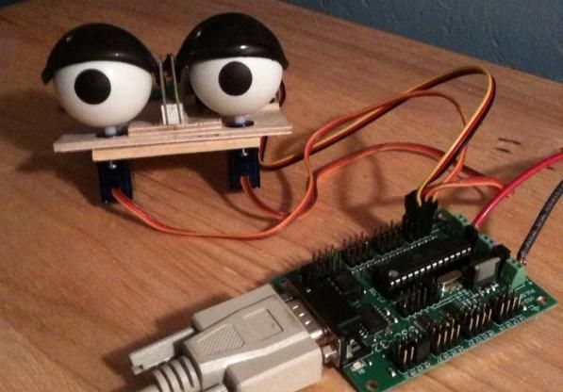
What are Animatronics?
Animatronics is defined as ‘the technique of making and operating lifelike robots, typically for use in film or other entertainment’
Most servos come with a set of attachments which are used to pull, push and move other objects
Attachment help you to create moving objects, such as a hand waving, legs walking, eyes looking and more
Wires and paper clips can be connected to the servo attachments and then to the leg / arm eye
The servo motor enables you to turn the attachment just the required amount so that the movement look realistic

Slide 4
Programming the Servo Recap
A pulse of 100 means a 1 millisecond pulse and the servo moves right
A pulse of 200 means a 2 millisecond pulse, the servo moves left
A pulse of 150 is a 1.5 millisecond and the servo moves towards the centre
A speed of 10 is 10 milliseconds for period 1/100 Hz, which is fairly fast
A speed of 50 is slow, set the speed to 100 and you will struggle to see the motor moving
Notes:
Recap the values used to control the Servo

Slide 5
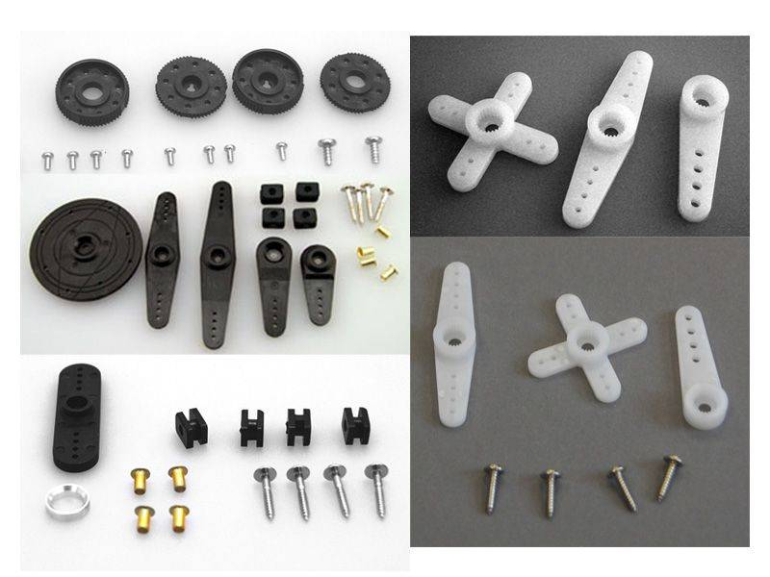
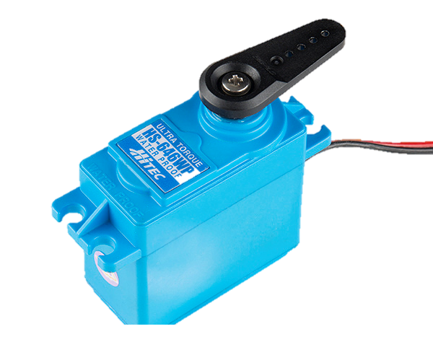
Different attachments
This Photo by Unknown Author is licensed under CC BY
https://hitecrcd.com/products/servos/servo-parts-and-accessories/servo-horns-and-hardware/product
Notes:
Show the Learners the different types of attachments and ask them how they think they could use them to create a moving element.
Learners attach the arm as shown in the image on the left - this is used in the practice activity tasks.

